Slide 1
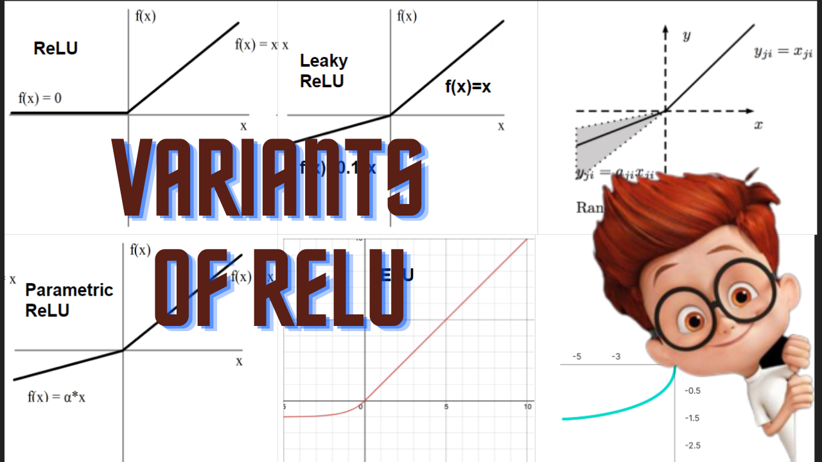

Slide 2
Variants of ReLU
Leaky ReLU
Randomized Leaky ReLU
Parametric ReLU
Exponential Linear Unit
Scaled Exponential Linear Unit

Slide 3
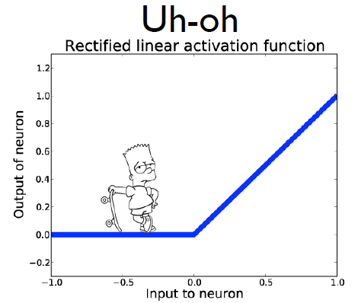
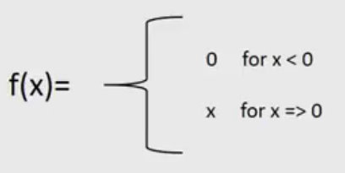
Dead Neurons
Y = ReLU(W*X+b)

Slide 4
Solution
?

Slide 5

Solution
X for x<0
Fraction of
input???

Slide 6
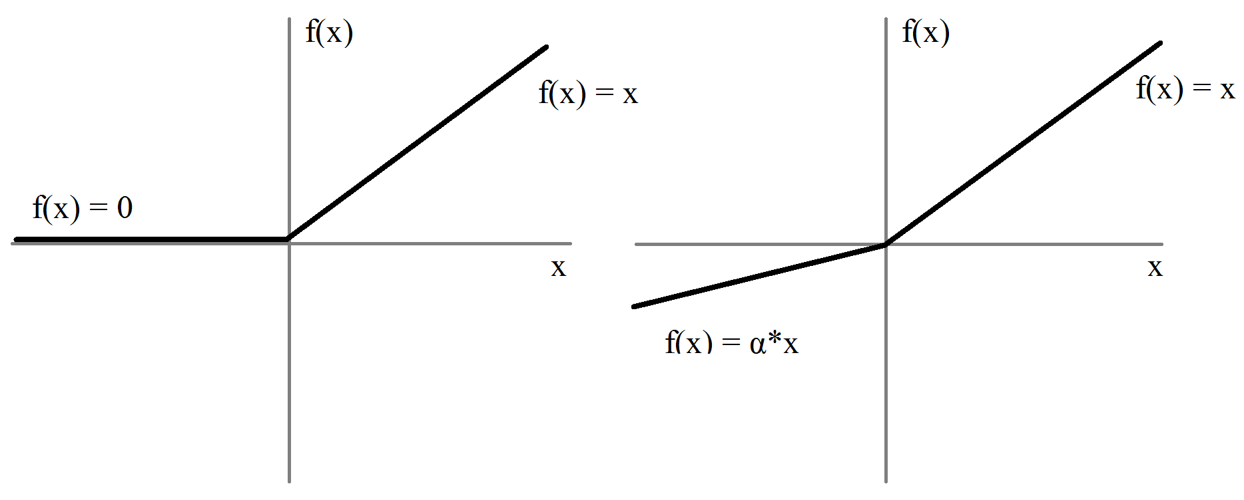
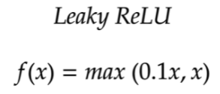
Leaky ReLU
f(x) = x
f(x) = 0.1* x

Slide 7
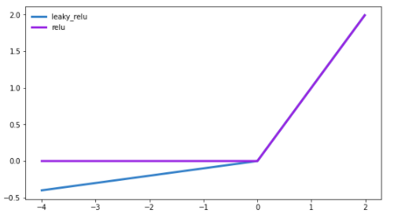
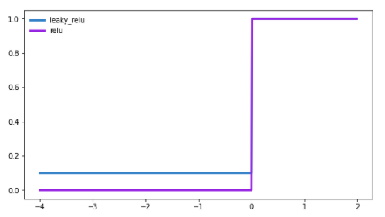
Derivatives
ReLU vs Leaky ReLU
Why 0.1?

Slide 8
Derivatives
ReLU vs Leaky ReLU
Why 0.1?
0.5
Random Value - [0,1]

Slide 9
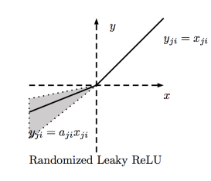

Randomized Leaky ReLU
‘a’ - Random sample from
Uniform Distribution [0,1)
NDSB kaggle competition:
(3,8)
l
u
Test time

Slide 10

Parametric ReLU
a - learned parameter

Slide 11
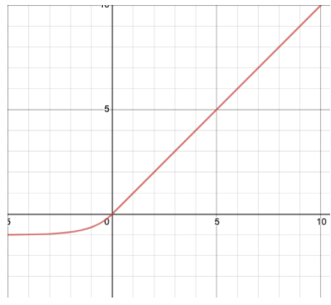
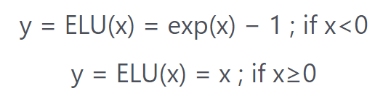
Exponential Linear Unit
Longer training times

Slide 12
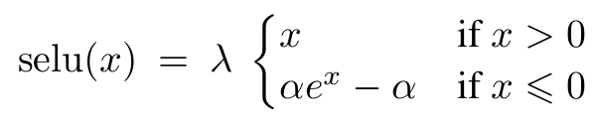


Scaled ELU
ELU if

Slide 13
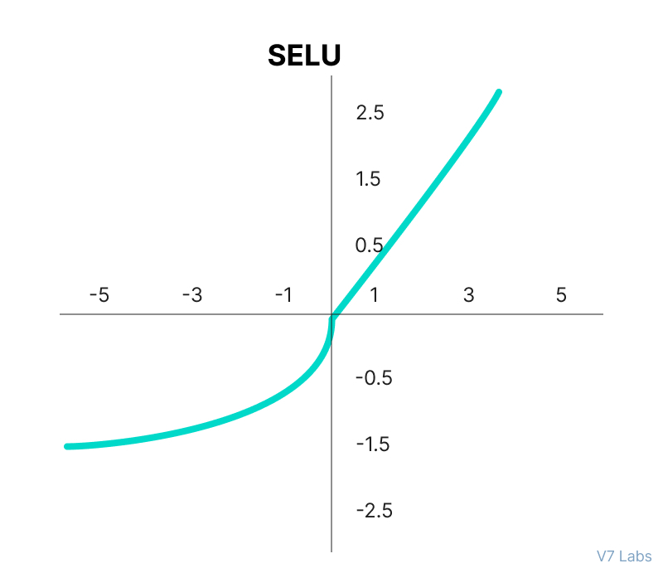
ELU

Slide 14
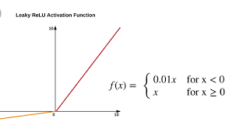
Summary
Leaky ReLU
ReLU
Parametric ReLU
ELU
Scaled ELU

Slide 15
ReLU
LeakyReLU
f(x)=x
f(x)=0.1*x
ELU
Parametric ReLU

